Slide 1
PIPAJS
AN OPEN-SOURCE MODULE
FOR EXPRESSJS
BY
FARIS
FOSSASIA 2016
Singapore Science Centre

Slide 2
ABOUT ME
Have been working in startups for the last 5 years
Full-stack Polyglot at CryoWerx
Speaker at google dev fest jakarta 2013
Developer Expert at #DevTalk by Tech-in-Asia Jakarta 2015
A Foodie & also an amateur Food-Photographer

Slide 3
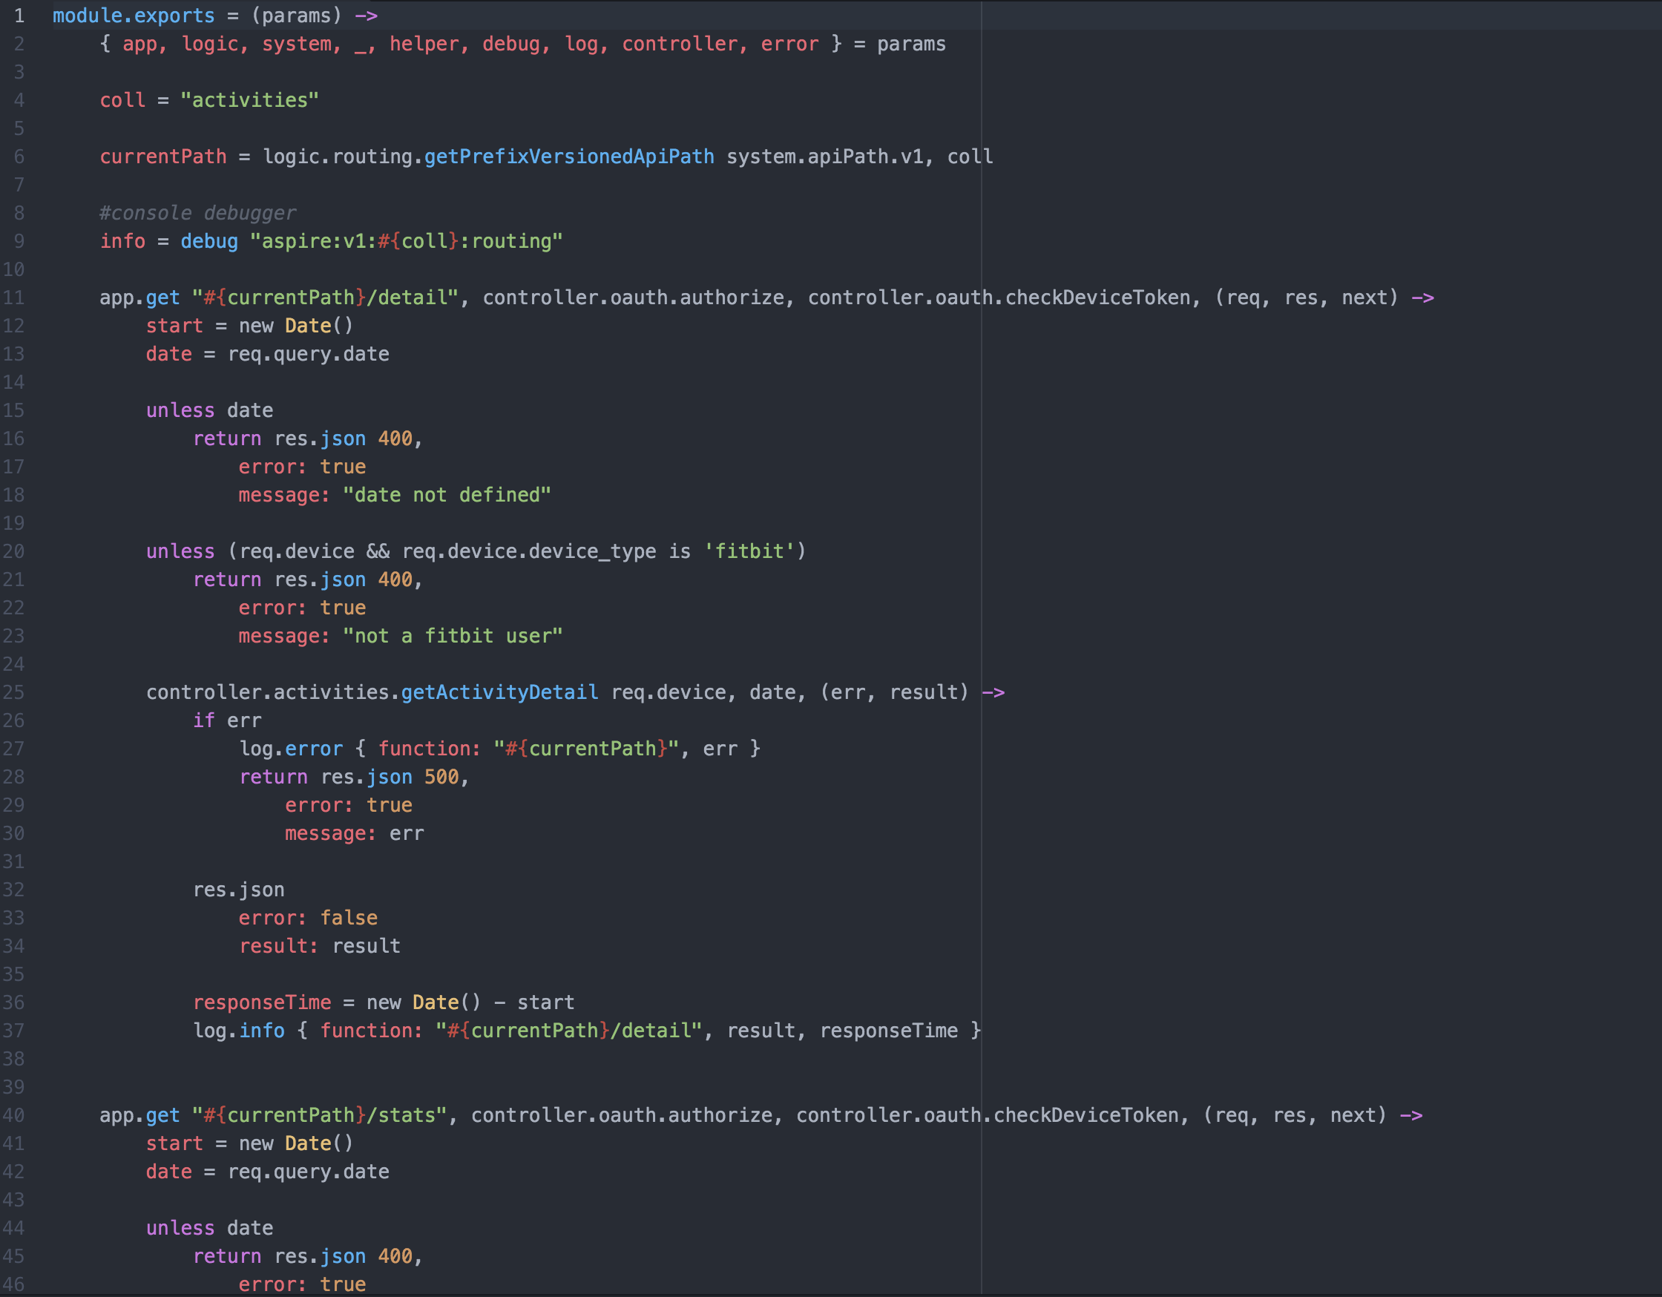
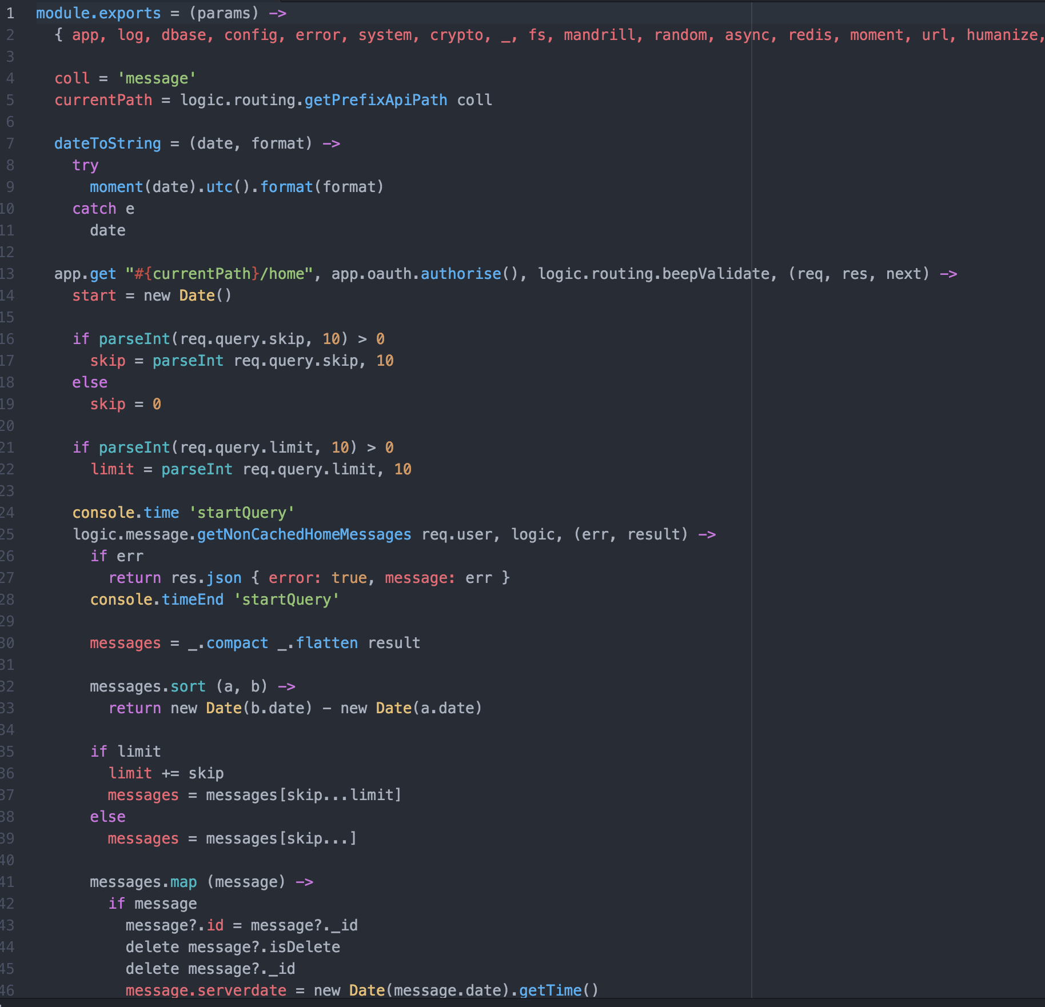

Slide 4
PIPAJS
From Bahasa Indonesia, which means “PIPE”
Super readable code-flow
Clean code
Easy-to-Use
Using JSON

Slide 5
STEP-BY-STEP usING PIpajs

Slide 7


Slide 8
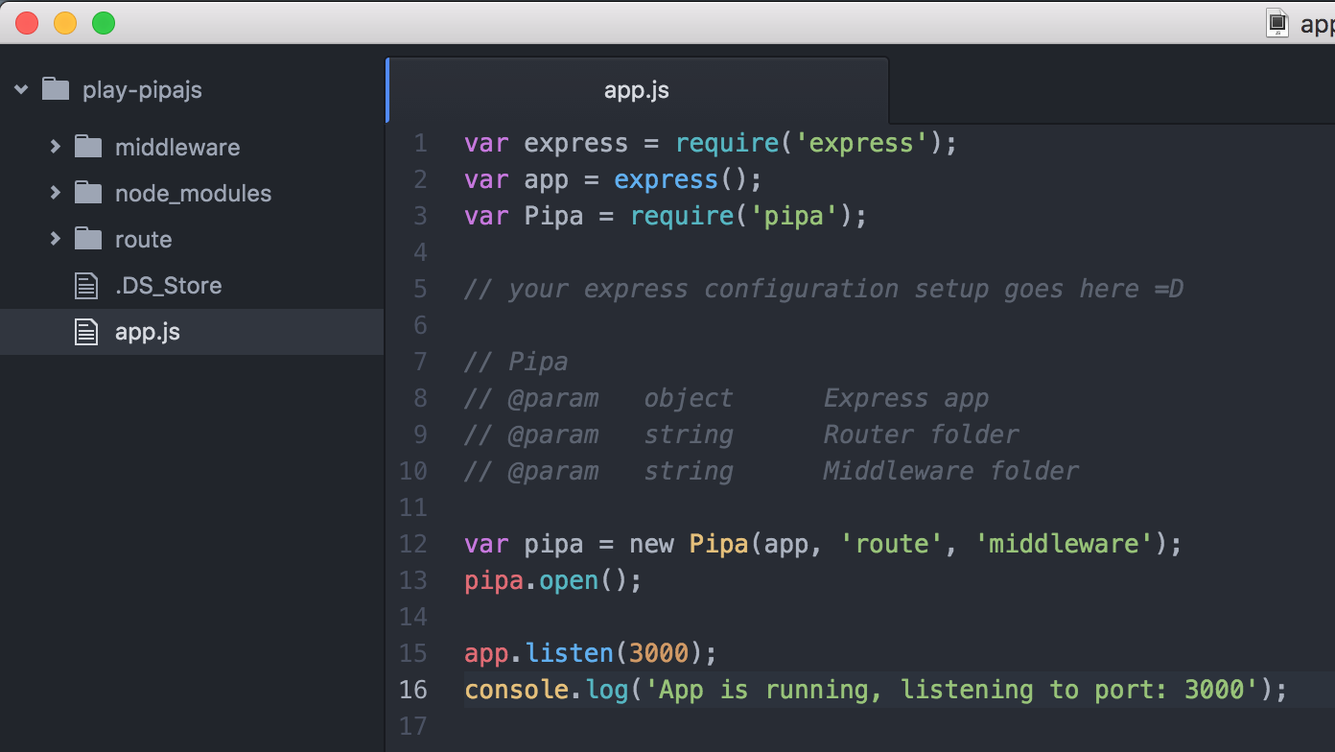

Slide 10
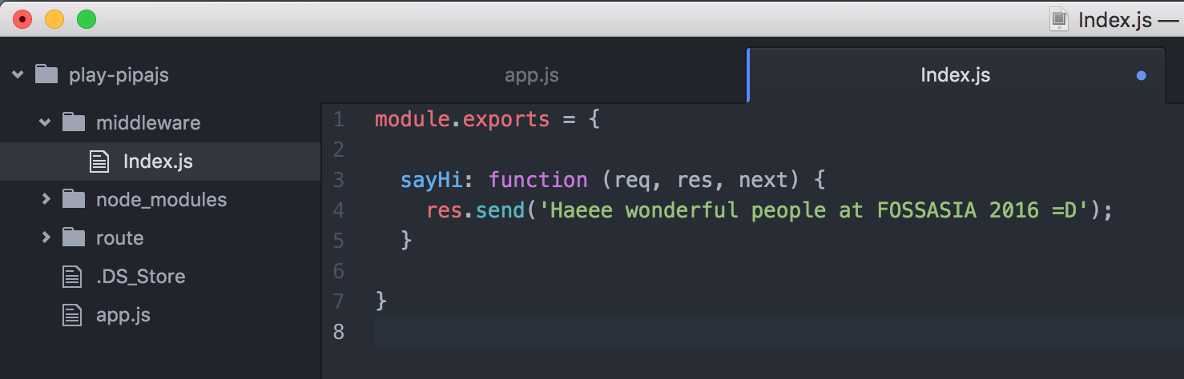

Slide 11


Slide 13
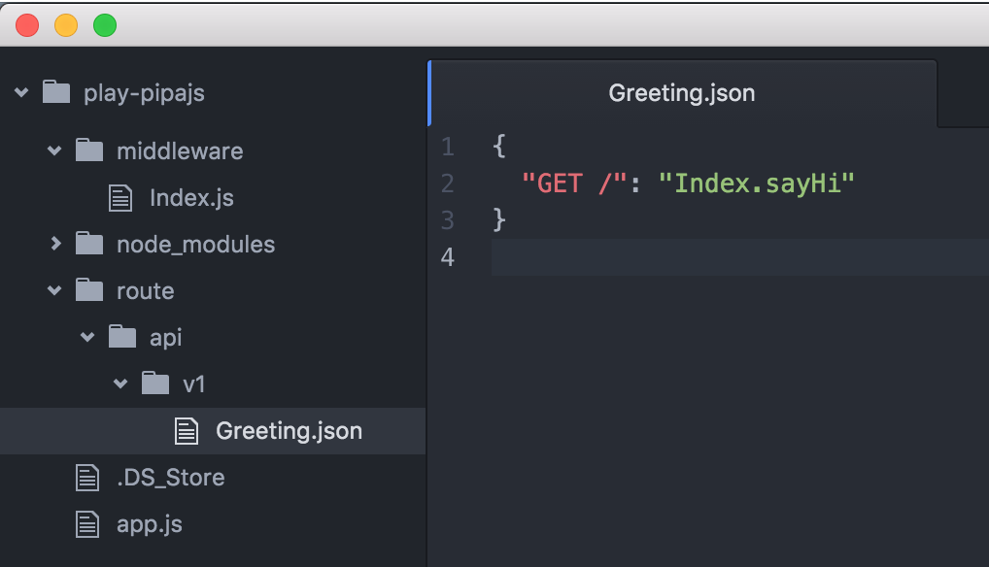

Slide 14
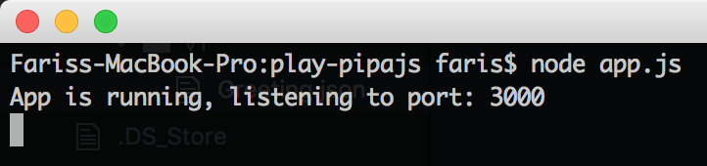
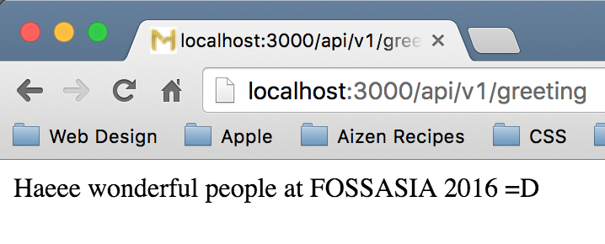

Slide 15
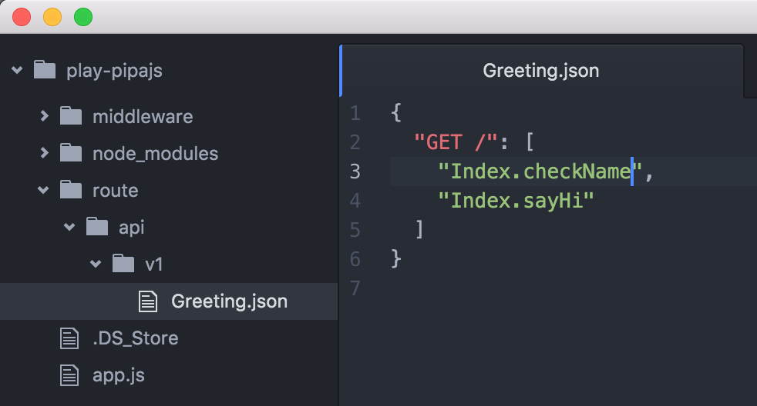

Slide 16
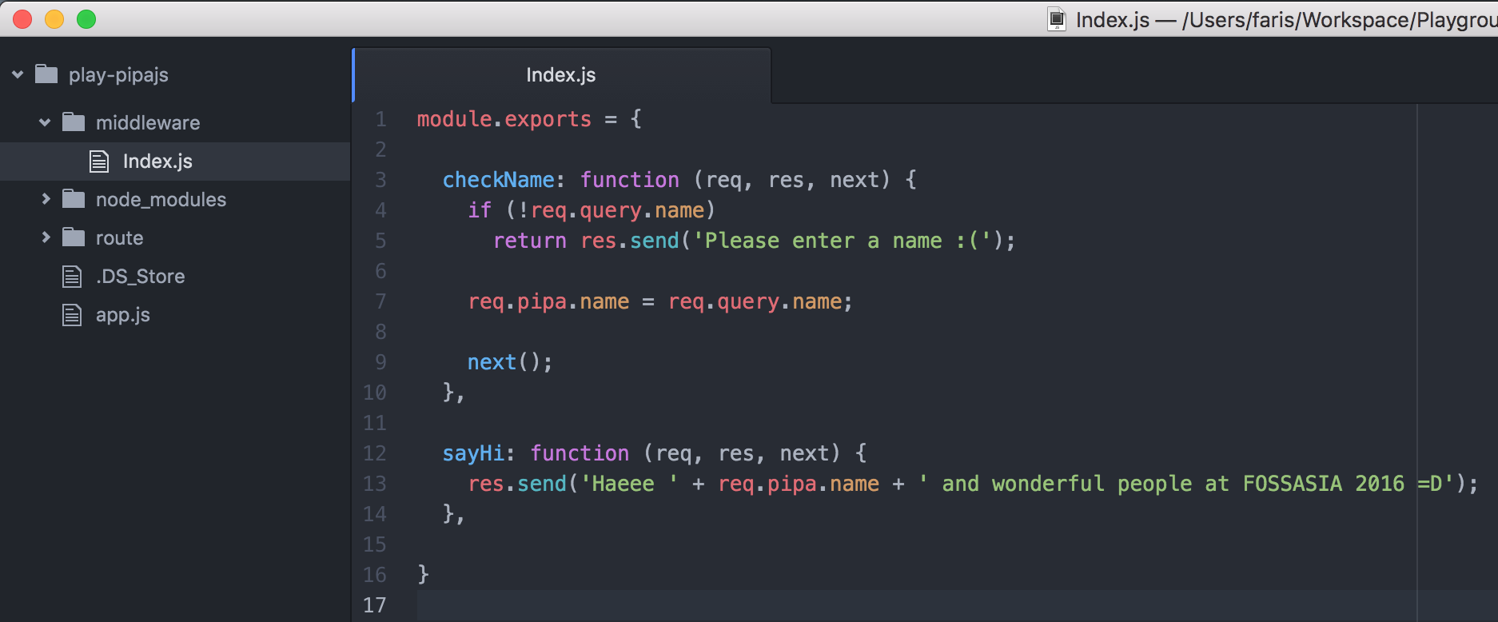

Slide 17
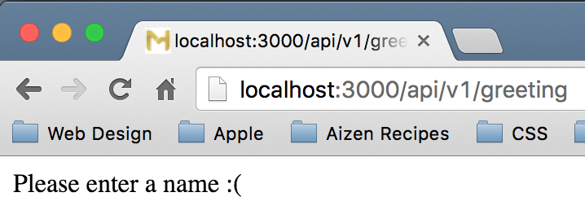

Slide 18
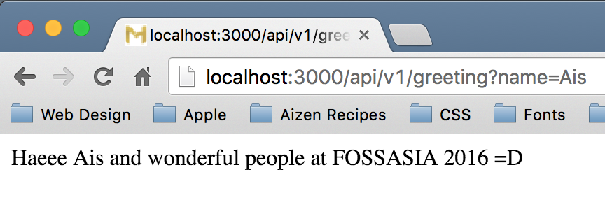

Slide 19
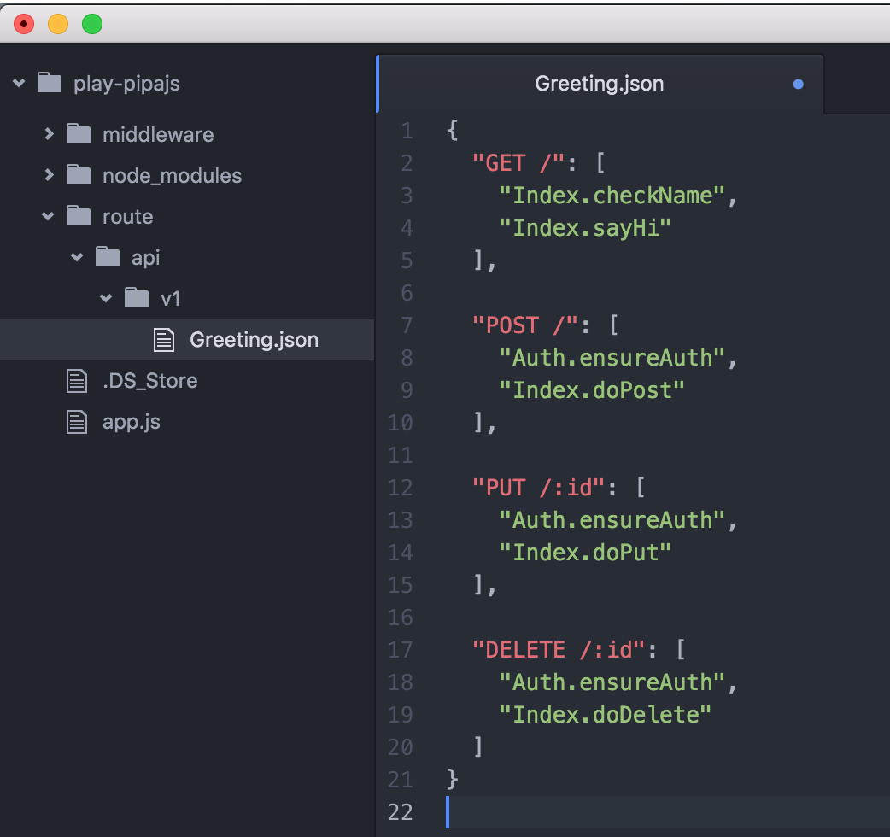

Slide 20
That’s it! Thank you
Twitter @farishjazz
Github /madebyais
Email madebyais@gmail.com
LinkedIn id.linkedin.com/in/farisf
www.madebyais.com

